Slide 1






2023 Big Data Neuroscience Workshop
Advanced Computational Neuroscience Network (ACNN)
The Ohio State University
September 14-5 2023

Slide 2







With many thanks to our sponsors!
The Translational Data Analytics Institute (TDAI)
The Center for Cognitive & Behavioral Brain Imaging (CCBBI)
The Department of Psychiatry and Behavioral Health
The Center for Clinical and Translational Science (CCTS)
The Neuroscience Research Institute (NRI)
The Center for Cognitive & Brain Sciences
Midwest Big Data Hub

Slide 3
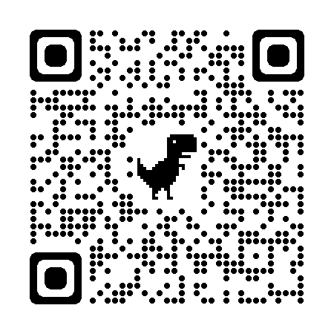
Logistics
The schedule is online: See the QR code
Restrooms are out and to the right
Do not close the door to the hallway please!
Boxed lunch will be served in the room across the hall both days
Please hang your posters in that same room

Slide 4
Logistics: Workshop tomorrow
Tomorrow’s workshop on reproducible neuroimaging practice will start EARLIER than originally planned
When the conference ends tomorrow, grab your lunch and come back here for the workshop!

Slide 5
Congratulations to our Travel Awardees!!
Simone Luchini, Penn State
Carly Lasagna, University of Michigan
Jacob Kraft, University of Michigan

